Slide 1

Bell Electricals Customer Analytics
This presentation is aimed at analyzing our customer database to generate insights that will improve our services.
Key Points of the presentation:
Customer demography
Customer satisfaction
Products’ level of importance
Preferred mode of shipment
Warehouse blocks usage

Slide 2
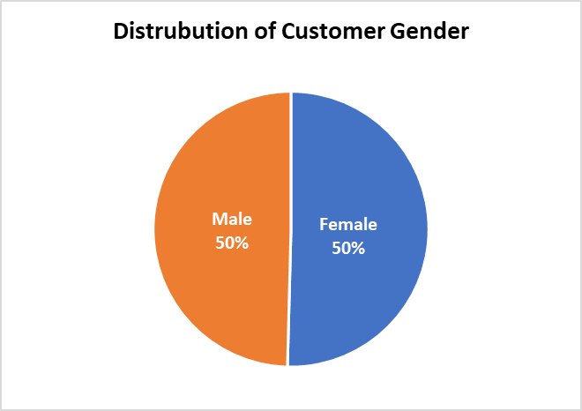
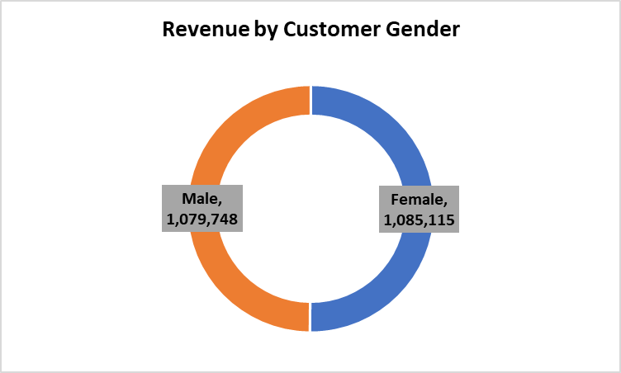
Customer Demography
Customer gender is evenly distributed as both categories have 50% representation each.
Almost equal revenue generated from each customer gender due to their even representation.

Slide 3
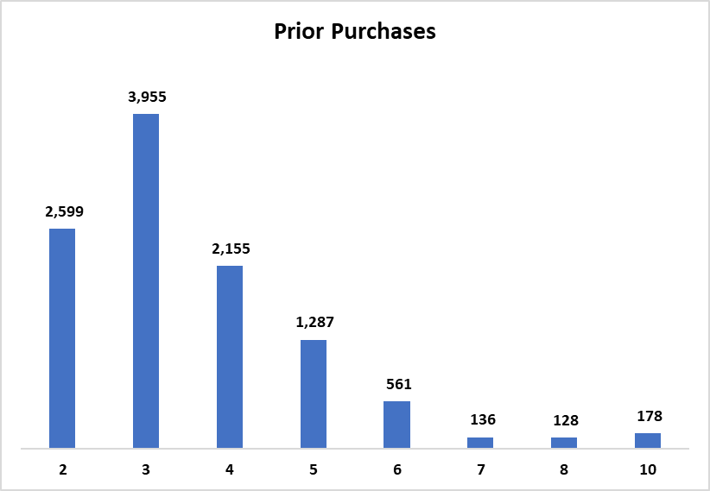
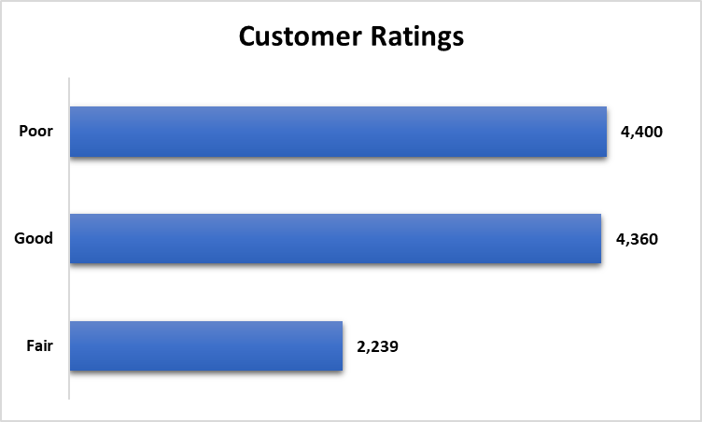
Customer Satisfaction
More poor ratings from customers than good and fair ratings.
Fairly good customer retainership.

Slide 4
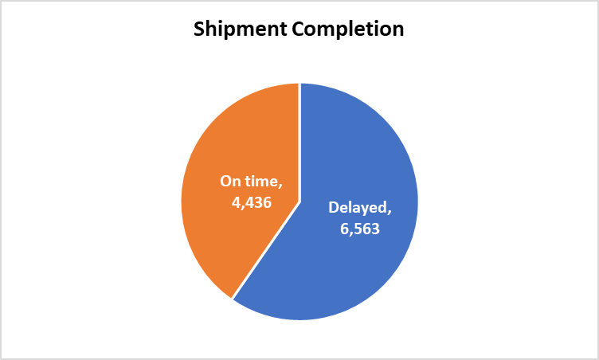
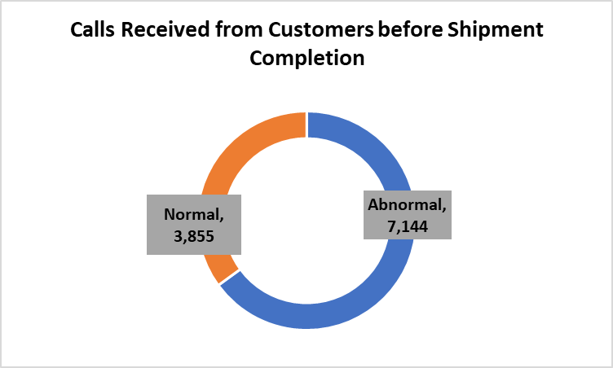
Customer Satisfaction
More shipments experience delays than those that don’t.
More abnormal calls received before shipment completion.
Normal calls: 1 to 3 calls.
Abnormal calls: more than 3 calls.

Slide 5
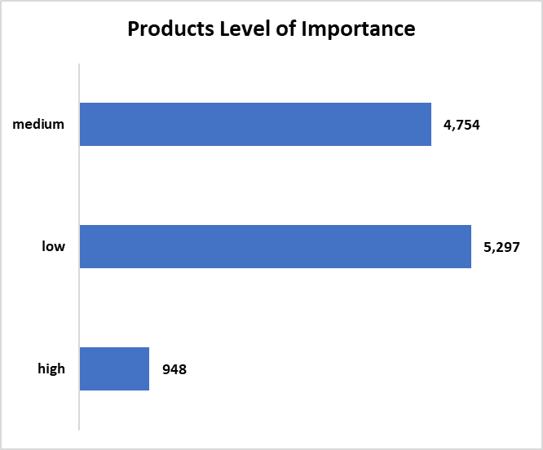
Products’ Level of Importance
Low patronage of highly important products

Slide 6
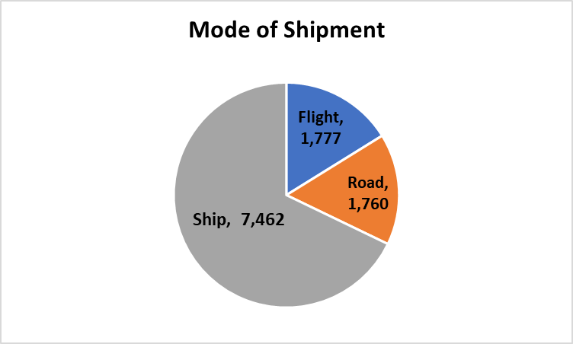
Preferred mode of Shipment
Shipping through the seas is the most preferred mode of shipment. This implies there are way more international shipments than local shipments.

Slide 7
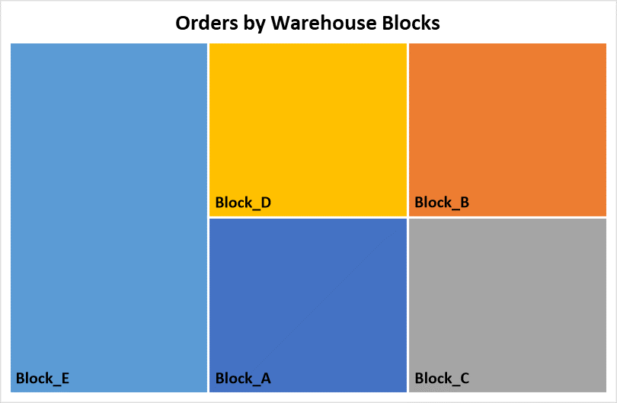
Warehouse Blocks Usage
Block E is the most used warehouse.
Other warehouses are equally used between themselves.

Slide 8
Conclusion
Customer demography: Customer location should be looked into. Type of customer (whether individual or a firm) should also be considered.
Customer satisfaction: Services should be improved to increase customer rating. This includes ensuring almost every shipment gets to its destination on time.
Development of strategies to improve the level of patronage of our highly important products. This includes marketing, promo and discounts.
Preferred mode of shipment: Local market should be targeted to improve shipments by road and flights.

